Slide 1



DEVELOPMENTAL
PSYCHOLOGY
CHERRIE L. RAGUNTON, PhD Cand., RPm

Slide 2

PRENATAL
INFANCY and TODDLERHOOD
EARLY CHILDHOOD
MIDDLE CHILDHOOD
TOPIC OUTLINE
ADOLESCENCE
EMERGING, MIDDLE AND LATE ADULTHOOD

Slide 3
ADDITIONAL CONCEPTS IN
HUMAN DEVELOPMENT

Slide 4

LIFESPAN vs LIFE EXPECTANCY
LIFESPAN, OR LONGEVITY, refers to the length of time a species can exist under the most optimal conditions.
The longest recorded lifespan for a human was Jean Calment who died in 1994 at the age of 122 years, 5 months, and 14 days .
LIFE EXPECTANCY is the predicted number of years a person born in a particular time period can reasonably expect to live.

Slide 5

CONCEPTIONS OF AGE
CHRONOLOGICAL
BIOLOGICAL
PSYCHOLOGICAL
SOCIAL
based on the number of years since your birth
how quickly the body is aging
psychologically adaptive capacity compared to others of our chronological age
based on the social norms of our culture and the expectations our culture has for people of our age group

Slide 6

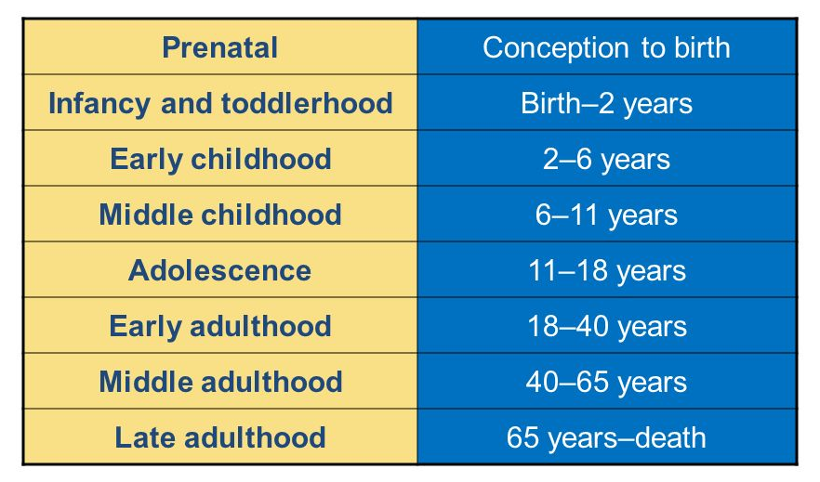
PERIODS OF DEVELOPMENT

Slide 7
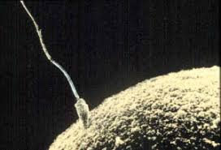
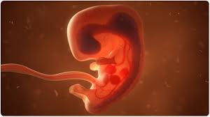

PRENATAL DEVELOPMENT
GERMINAL PERIOD
EMBRYONIC PERIOD
FETAL PERIOD
about 14 days in length
lasts from conception to implantation of the fertilized egg in the lining of the uterus
a new cell, ZYGOTE is formed
Starting the third week the blastocyst has implanted in the uterine wall.
Upon implantation this multi-cellular organism is called an embryo.
blood vessels grow forming the placenta.
From the ninth week until birth
major structures are continuing to develop
age of viability is reached at about 24 weeks

Slide 8
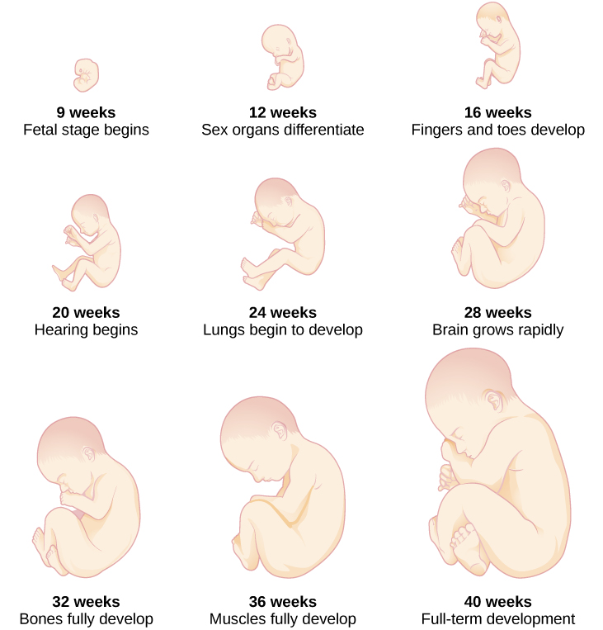

Slide 9
TERATOLOGY
The study of factors that contribute to birth defects.
TERATOGENS
Environmental factors that can contribute to birth defects, and include some maternal diseases, pollutants, drugs and alcohol.

Slide 10


ALCOHOL
TOBACCO
ILLICIT DRUGS
neurocognitive and behavioral difficulties
low birth weight, ecotopic pregnancy
low birth weight, stillbirths and spontaneous abortion.
TERATOGENS IMPACT
flattened noses, small eye holes, and small heads
preterm delivery, stillbirth, fetal growth restriction, sudden infant death syndrome
learning and behavior difficulties, slower than normal growth
poor judgment, poor impulse control, higher rates of ADHD, learning issues, and lower IQ scores
birth defects, learning disabilities, and early puberty in girls
birth defects, heart defects, and infections

Slide 11
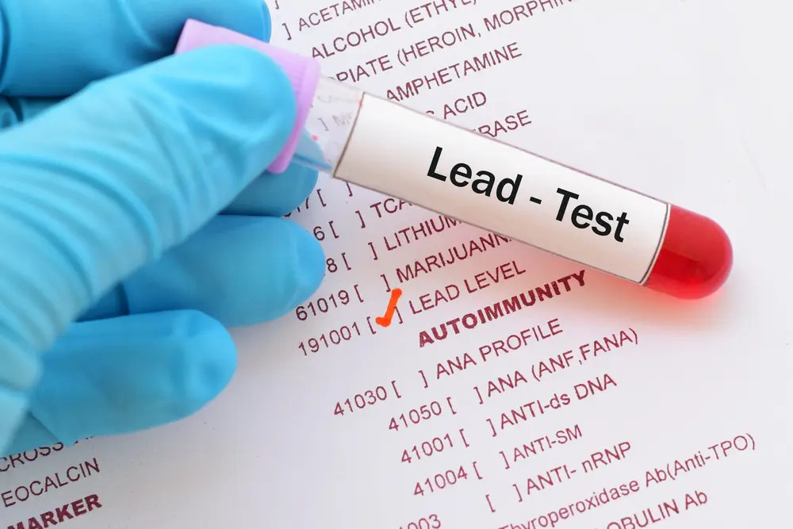




LEAD
PESTICIDES
BISPHENOL A
POLLUTANTS
RADIATION
MERCURY

Slide 12

PRENATAL ASSESSMENT
ULTRASOUND - sound waves are used to examine the fetus.
AMNIOCENTESIS - procedure in which a needle is used to withdraw a small amount of amniotic fluid and cells from the sac surrounding the fetus and later tested.
CHORIONIC VILLUS SAMPLING is a procedure in which a small sample of cells is taken from the placenta and tested.

Slide 13
PREGNANCY COMPLICATIONS
MINOR COMPLICATIONS
nausea (first 3-4 months of pregnancy) heartburn, gas, hemorrhoids, backache, leg cramps, insomnia, constipation, shortness of breath or varicose veins.
ECTOPIC PREGNANCY
occurs when the zygote becomes attached to the fallopian tube before reaching the uterus, abdominal pain, vaginal bleeding, nausea and fainting.
PREECLAMPSIA/ TOXEMIA
characterized by a sharp rise in blood pressure, a leakage of protein into the urine as a result of kidney problems, and swelling of the hands, feet, and face during the third trimester of pregnancy.
SPONTANEOUS ABORTION
body aborts due to chromosomal abnormalities, and this typically happens before the 12th week of pregnancy, Cramping and bleeding.

Slide 14
INFANCY AND TODDLERHOOD

Slide 15
average newborn weighs about 7.5 pounds (between 5 and 10 pounds) and is about 20 inches in length.
4 months old, it usually doubles in weight and by one year has tripled the birth weight.
the head makes up about 25 percent of our length, and by age 25 it comprises about 20 percent our length.
We are born with most of the brain cells that we will ever have; about 85 billion neurons whose function is to store and transmit information.
SYNAPTOGENESIS, or the formation of connections between neurons, continues from the prenatal period forming thousands of new connections during infancy and toddlerhood.
SYNAPTIC BLOOMING- period of rapid neural growth.
PHYSICAL

Slide 16
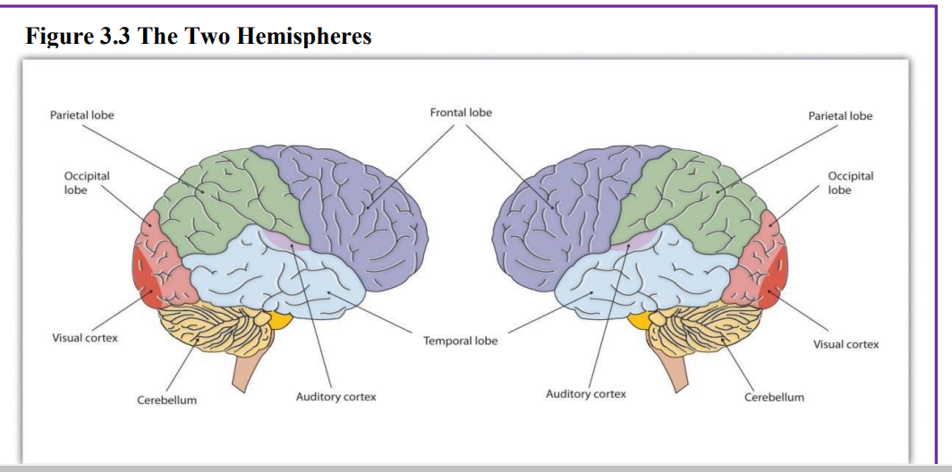

Slide 17
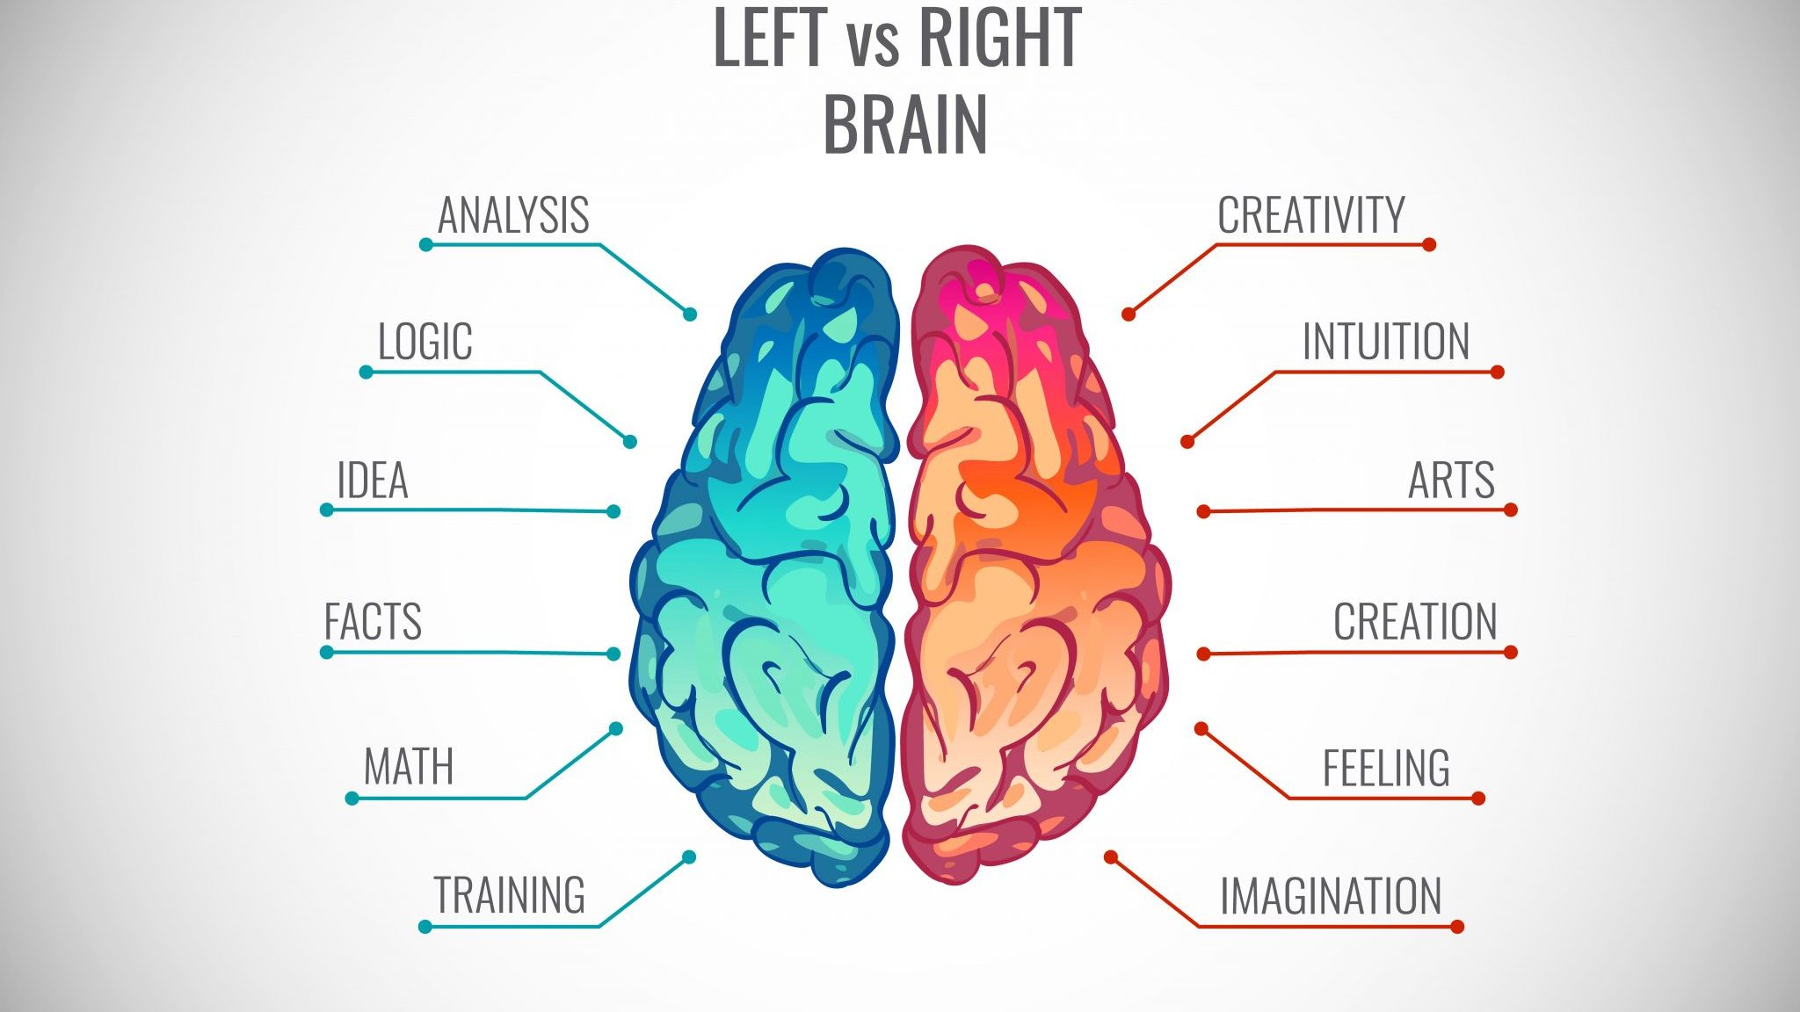

Slide 18

The brain grows rapidly during infancy.
Primary motor areas develop earlier than primary sensory areas, and the prefrontal cortex, that is located behind the forehead, is the least developed
As the prefrontal cortex matures, the child is increasingly able to regulate or control emotions, to plan activities, strategize, and have better judgment.
This is not fully accomplished in infancy and toddlerhood, but continues throughout childhood, adolescence and into adulthood.

Slide 19

LATERALIZATION - the process in which different functions become localized primarily on one side of the brain.
NEUROPLASTICITY refers to the brain’s ability to change, both physically and chemically, to enhance its adaptability to environmental change and compensate for injury.
The brain’s neurons have a remarkable capacity to reorganize and extend themselves to carry out particular functions (vision and hearing) in response to the needs of the organism, and to repair any damage.
Brain constantly creates new neural communication routes and rewires existing ones. Environmental experiences and hormones, genes and age affect the brain’s plasticity.

Slide 20
REFLEX | DESCRIPTION
SUCKING | Suck on anything that touches the lips
ROOTING | Turning the head when the cheek is touched
GRASP | Fingers automatically grip anything that touches the palm of the hand
BABINSKI | The toes will fan out and curl when the sole of the foot is stroked from heel to toe
MORO | A sudden noise or loss of support to the head and neck will cause infants to spread out their arms and legs then quickly contract the limbs inward.
TONIC NECK | When lying on the back with the head to one side infants will extend the arm and leg on that side while flexing the limbs on the opposite side (looks like a fencer pose).
STEPPING | Legs move in stepping like motion when feet touch a smooth surface.

Slide 21
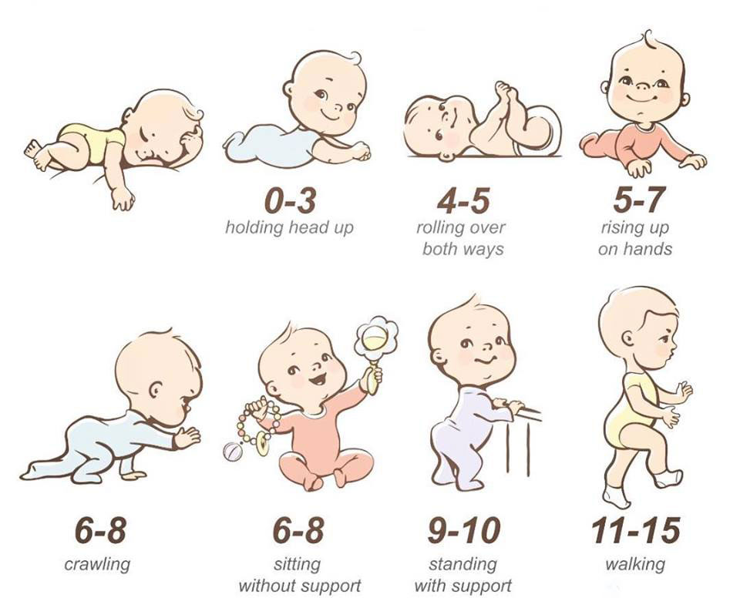

Slide 22
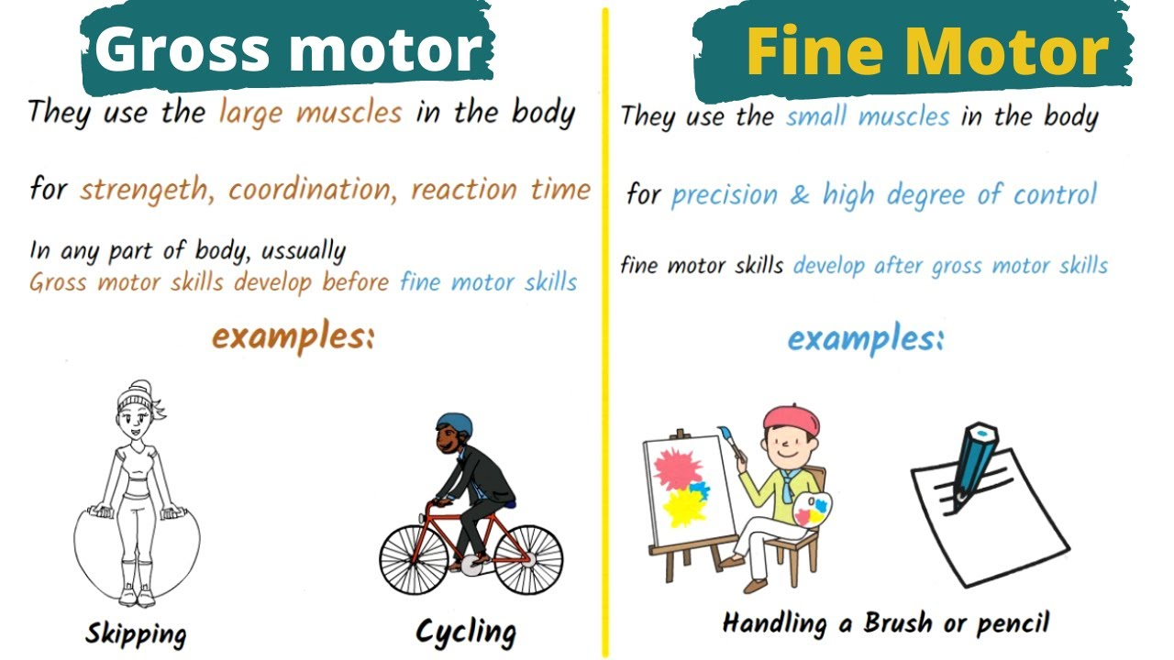

Slide 23

PALMER GRASP - At about 4 months, grasping an object involves the use of the fingers and palm, but no thumbs.
PINCER GRASP - the use of the thumb comes at about 9 months of age when the infant is able to grasp an object using the forefinger and thumb.
This ability greatly enhances the ability to control and manipulate an object.

Slide 24



Information needs to be organized, and a framework for organizing information is referred to as a SCHEMA.
Piaget believed that we are continuously trying to maintain cognitive equilibrium, or a balance, in what we see and what we know.
PIAGET AND THE SENSORIMOTOR STAGE
ACCOMMODATION - is expanding the framework of knowledge to accommodate the new situation, thus learning a new word to more accurately name the animal.
ASSIMILATION - fitting the new information into an existing schema.

Slide 25
PIAGET’S CONCEPTS
OBJECT PERMANENCE
understanding that even if something is out of sight, it still exists.
STRANGER ANXIETY
fear of unfamiliar people, results when a child is unable to assimilate the stranger into an existing schema; therefore, she cannot predict what her experience with that stranger will be like.
INFANTILE AMNESIA
the inability to recall memories from the first few years of life, due to the immaturity of the infant brain or lack of linguistic skills of babies and toddlers limit their ability to mentally represent events.

Slide 26
LANGUAGE COMPONENTS
TERM | DESCRIPTION
PHONEMES | smallest unit of sound that makes a meaningful difference in a language. The word “bit” has three phonemes.
MORPHEME | a string of one or more phonemes that makes up the smallest units of meaning in a language.
SEMANTICS | set of rules we use to obtain meaning from morphemes. For example, adding “ed” to the end of a verb makes it past tense.
SYNTAX | set of rules of a language by which we construct sentences. “The man bites the dog” is different from “The dog bites the man.”
PRAGMATIC | how we communicate effectively and appropriately with others; volume and tone of voice, and appropriate eye contact.
CONTEXTUAL INFORMATION | information surrounding language, to help us interpret it; knowledge and nonverbal expressions, such as facial expressions, postures, and gestures

Slide 27

TEMPERAMENT is the innate characteristics of the infant, including mood, activity level, and emotional reactivity, noticeable soon after birth.
At birth, infants exhibit two emotional responses: ATTRACTION AND WITHDRAWAL.

Slide 28

BASIC EMOTIONS, such as interest, happiness, anger, fear, surprise, sadness and disgust, which appear first.
SELF-CONSCIOUS EMOTIONS, such as envy, pride, shame, guilt, doubt, and embarrassment.
Unlike primary emotions, SECONDARY EMOTIONS appear as children start to develop a self-concept and require social instruction on when to feel such emotions.
EMOTIONAL SELF-REGULATION refers to strategies we use to control our emotional states so that we can attain goals. This requires effortful control of emotions and initially requires assistance from caregivers.

Slide 29
the realization that you are separate from others.
Once a child has achieved this, he is moving toward understanding social emotions such as guilt, shame or embarrassment, as well as, sympathy or empathy.
SELF-AWARENESS
ATTACHMENT
is the close bond with a caregiver from which the infant derives a sense of security.
Form the basis for confidence and curiosity as toddlers, and as important influences on self- concept.

Slide 30
FREUD’S PSYCHOANALYTIC THEORY: infants are oral creatures who obtain pleasure from sucking and mouthing objects. Freud believed the infant will become attached to a person or object that provides this pleasure.
HARLOW’S RESEARCH:
The infant's need for physical closeness and touching is referred to as CONTACT COMFORT - believed to be the foundation for attachment.
ERIKSON: TRUST VS. MISTRUST
The first year to year and a half of life involves the establishment of a sense of trust.
Infants are dependent and must rely on others to meet their basic physical needs as well as their needs for stimulation and comfort.
BOWLBY’S THEORY:
An infant must form this bond with a primary caregiver in order to have normal social and emotional development.
A SECURE BASE is a parental presence that gives the child a sense of safety as the child explores the surroundings.

Slide 31
EARLY CHILDHOOD

Slide 32
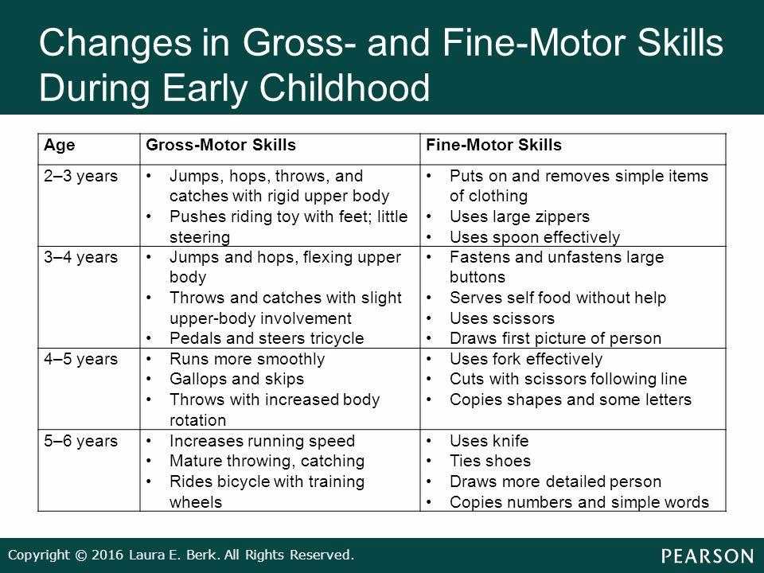

Slide 33
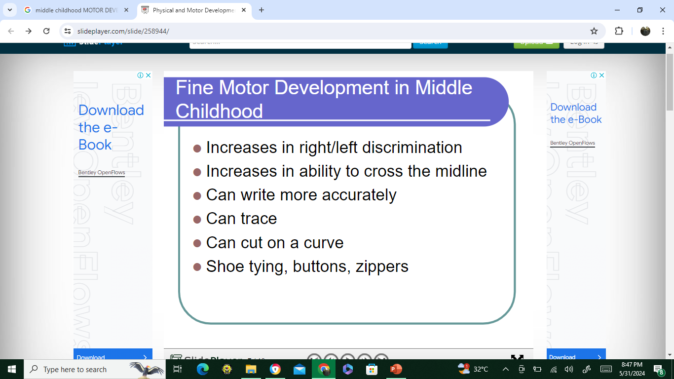

Slide 34

TOILET TRAINING
typically occurs during the first two years of early childhood (24-36 months).
Some children show interest by age 2, but others may not be ready until months later.
seem interested in the potty chair or toilet, or in wearing underwear?
understand and follow basic directions?
complain about wet or dirty diapers?
tell you through words, facial expressions or posture when he or she needs to go?
pull down his or her pants and pull them up again?
sit on and rise from a potty chair?

Slide 35
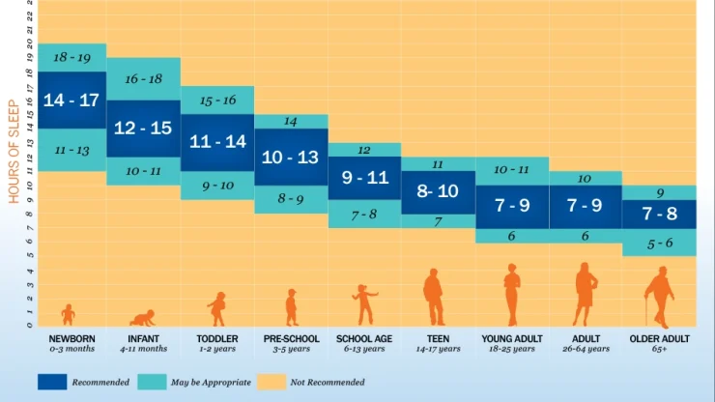

Slide 36

SEXUAL DEVELOPMENT
SELF-STIMULATION is common in early childhood for both boys and girls.
Curiosity about the body and about others’ bodies is a natural part of early childhood as well.
As children grow, they are more likely to show their genitals to siblings or peers, and to take off their clothes and touch each other.
Hopefully, parents respond to this without undue alarm and without making the child feel guilty about their bodies.

Slide 37

begin to use language, but they cannot understand adult logic or mentally manipulate information.
occurs from the age of 2 to 7 years.
children use symbols to represent words, images, and ideas, which is why children in this stage engage in pretend play.
PIAGET AND PREOPERATIONAL STAGE
Children’s logic is based on their own personal knowledge of the world so far, rather than on conventional knowledge. .

Slide 38
TWO STAGES OF PREOPERATIONAL STAGE
SYMBOLIC FUNCTION SUBSTAGE
occurs between 2 and 4 years of age and is characterized by the child being able to mentally represent an object that is not present and a dependence on perception in problem solving.
INTUITIVE THOUGHT SUBSTAGE
lasting from 4 to 7 years, is marked by greater dependence on intuitive thinking rather than just perception

Slide 39
OTHER CONCEPTS
the tendency of young children not to be able to take the perspective of others, and instead the child thinks that everyone sees, thinks, and feels just as they do.
EGOCENTRISM
CONSERVATION
refers to the ability to recognize that moving or rearranging matter does not change the quantity.
CENTRATION
focused on only one characteristic of an object to the exclusion of others.
ANIMISM
refers to attributing life-like qualities to objects.

Slide 40

Both Piaget and Vygotsky believed that children actively try to understand the world around them, referred to as CONSTRUCTIVISM.
CHILDREN’S UNDERSTANDING OF THE WORLD
Piaget is identified as a COGNITIVE CONSTRUCTIVITST, which focuses on independent learning.
Vygotsky is a SOCIAL CONSTRUCTIVIST relying on social interactions for learning.

Slide 41
LANGUAGE DEVELOPMENT
DEVELOPMENT | DESCRIPTION
VOCABULARY GROWTH | A child’s vocabulary expands between the ages of two to six from about 200 words to over 10,000 words
FAST-MAPPING | Words are easily learned by making connections between new words and concepts already known.
LITERAL MEANINGS | Children can repeat words and phrases after having heard them only once or twice, but they do not always understand the meaning of the words or phrases.
OVERREGULARIZATION | Children learn rules of grammar as they learn language but may apply these rules inappropriately at first. “I goed there. I doed that.”
BILINGUAL | meaning that they understand and use two languages. They will show higher expressive and receptive skills in the language they come to hear the most.

Slide 42

PRESCHOOL PREPARATIONS
Positive relationships among all children and adults are promoted.
A curriculum that supports learning and development in social, emotional, physical, language, and cognitive areas.
Teaching approaches that are developmentally, culturally and linguistically appropriate
Collaborative relationships with families are established and maintained
The indoor and outdoor physical environments are safe and well-maintained.

Slide 43
SPANKING and DISCIPLINE
Many alternatives to spanking are advocated by child development specialists and include:
Praising and modeling appropriate behavior
Providing time-outs for inappropriate behavior
Giving choices
Helping the child identify emotions and learning to calm down
Ignoring small annoyances
Withdrawing privileges

Slide 44
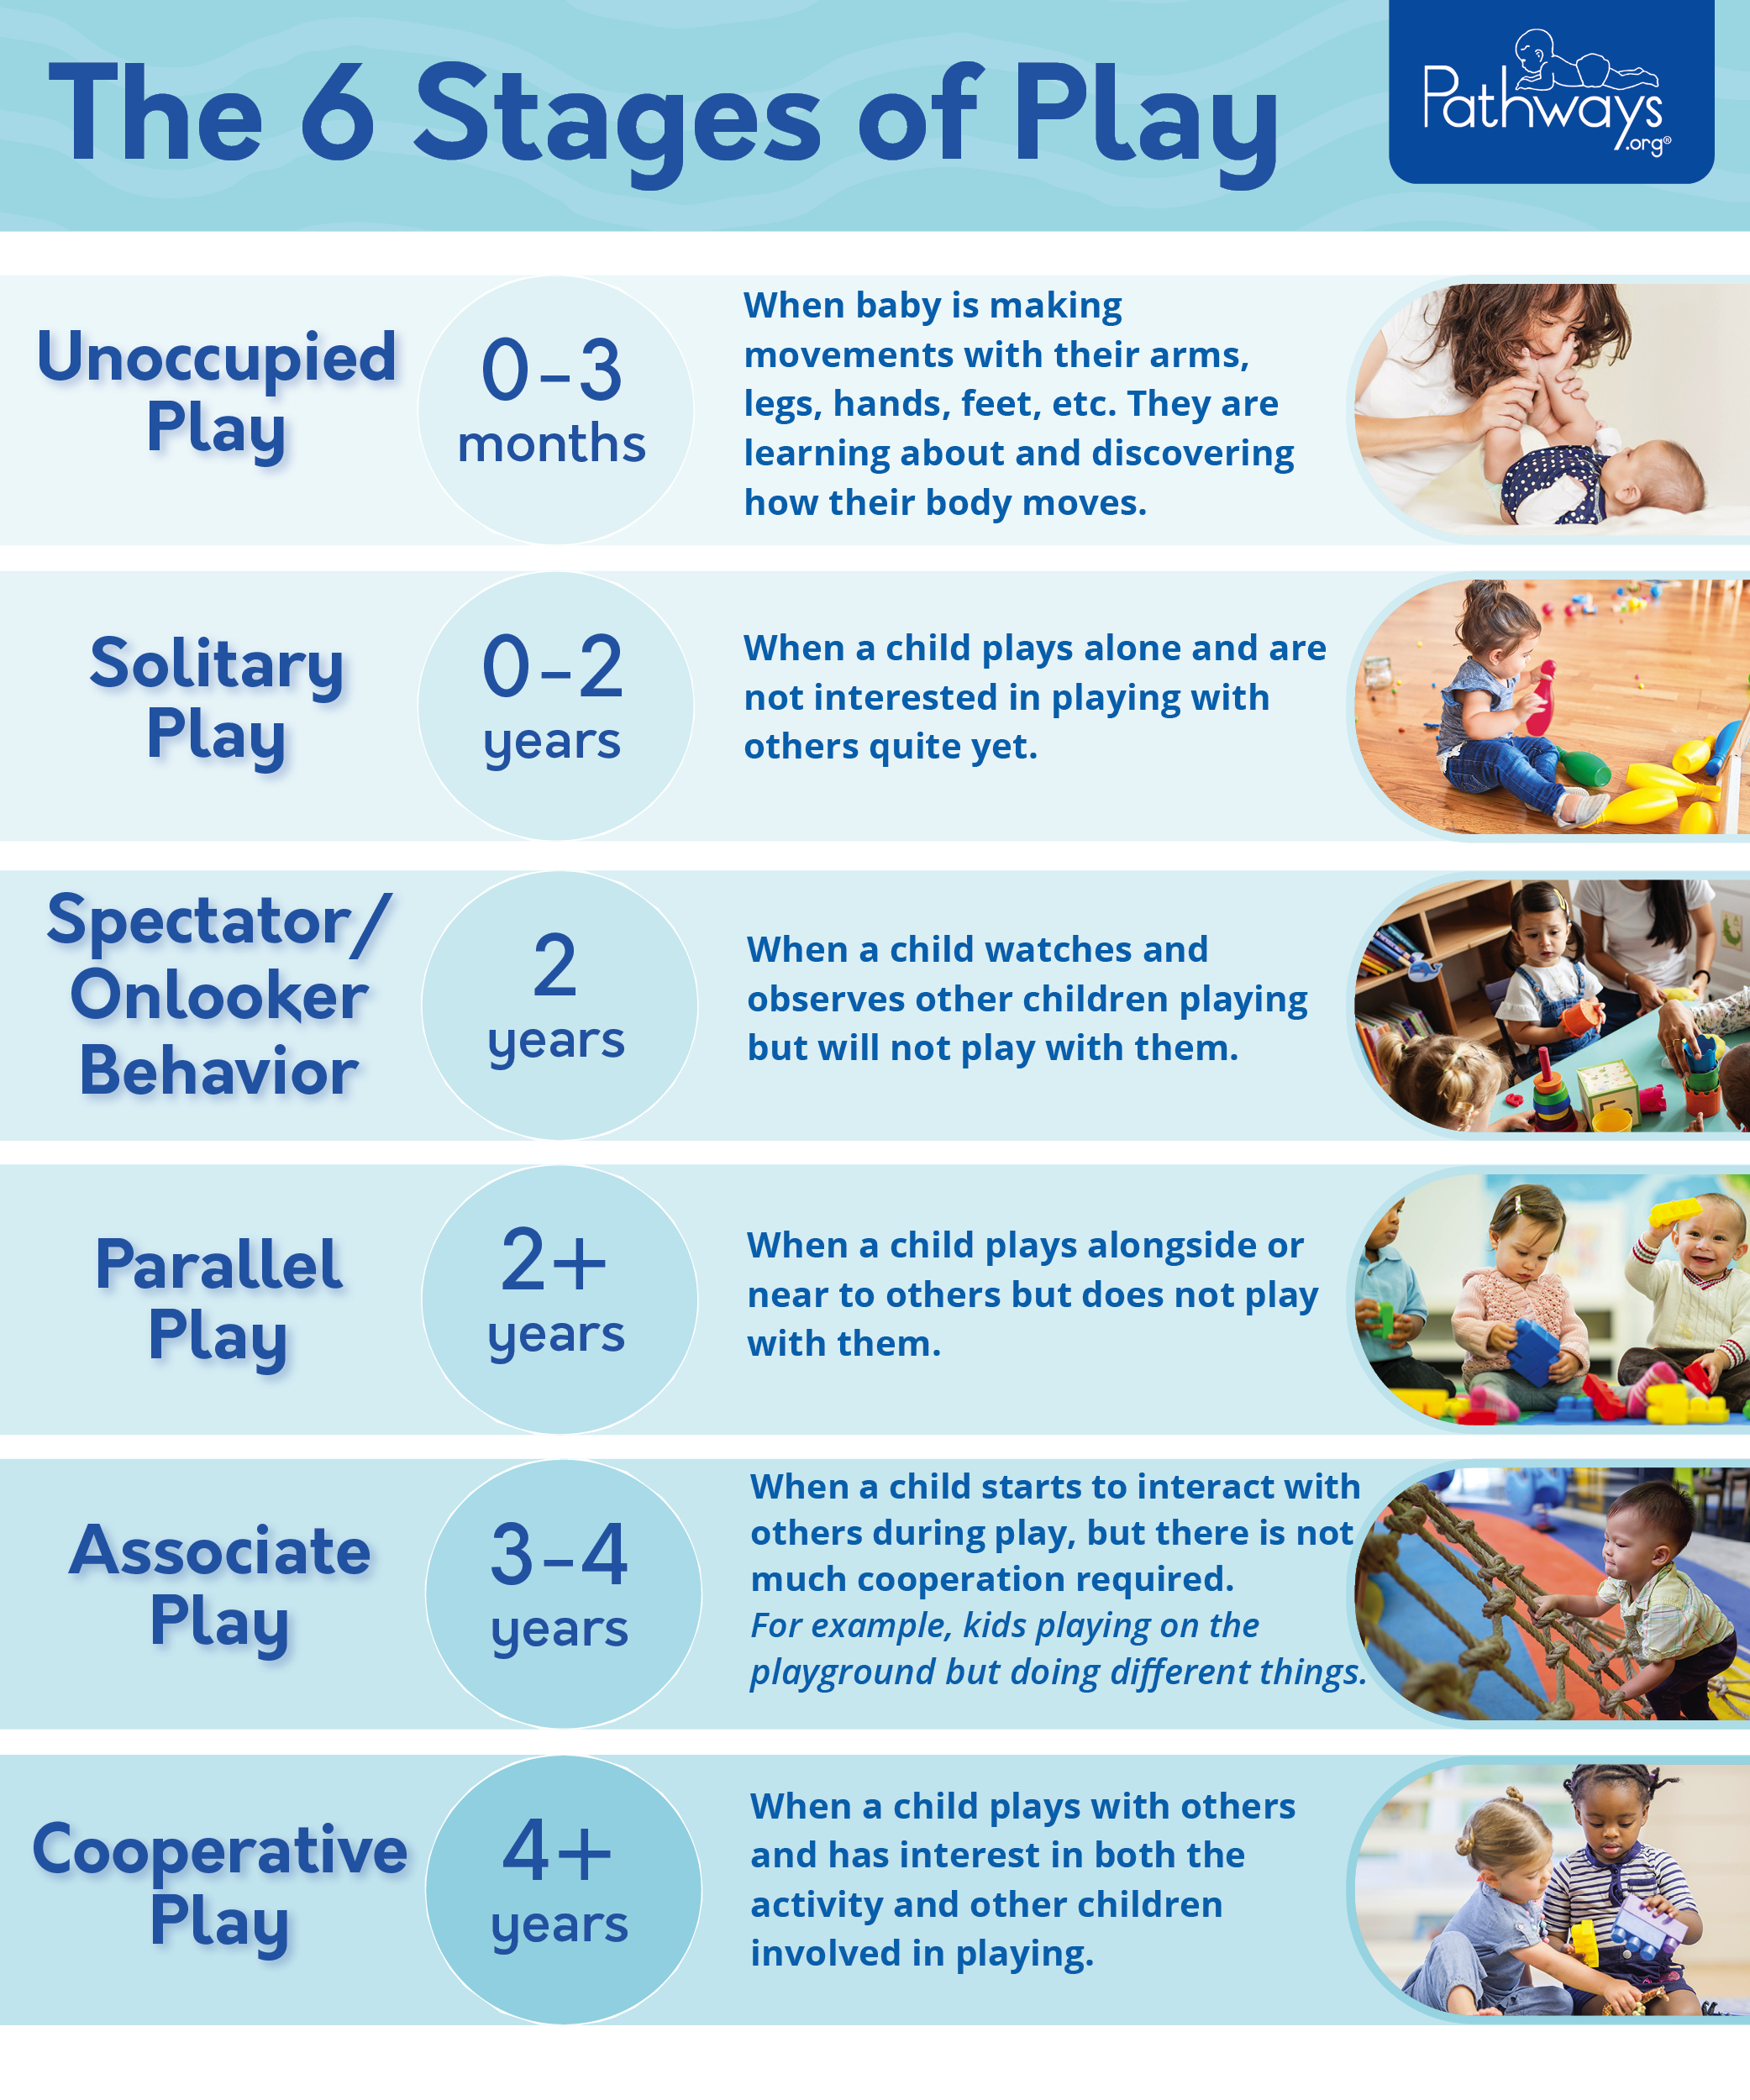

Slide 45
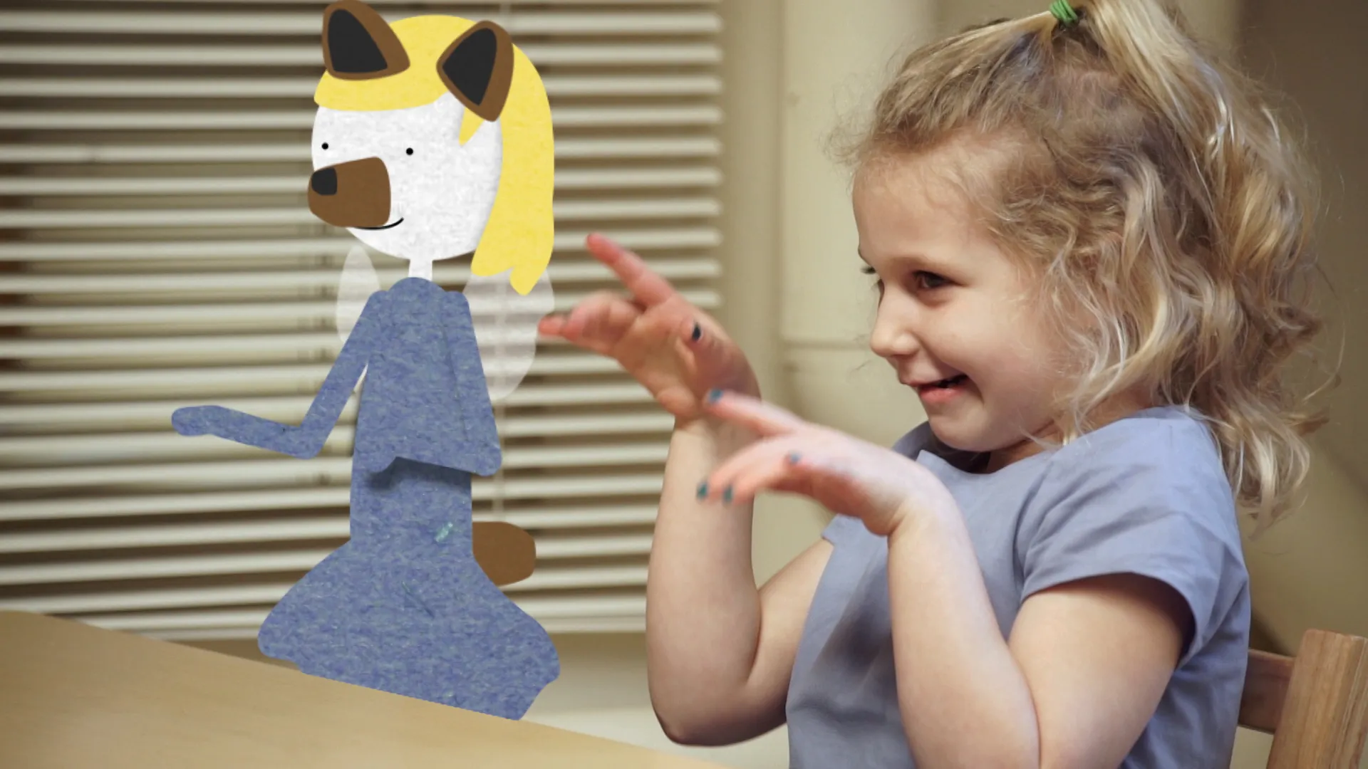

Slide 46
CHILD ABUSE
ABUSE | DESCRIPTION
SEXUAL ABUSE | defined as any sexual contact between a child and an adult or a much older child.
INCEST | refers to sexual contact between a child and family members.
ADVERSE CHILDHOOD EXPERIENCES (ACES) | All types of abuse, neglect, and other potentially traumatic experiences that occur before the age of 18.

Slide 47
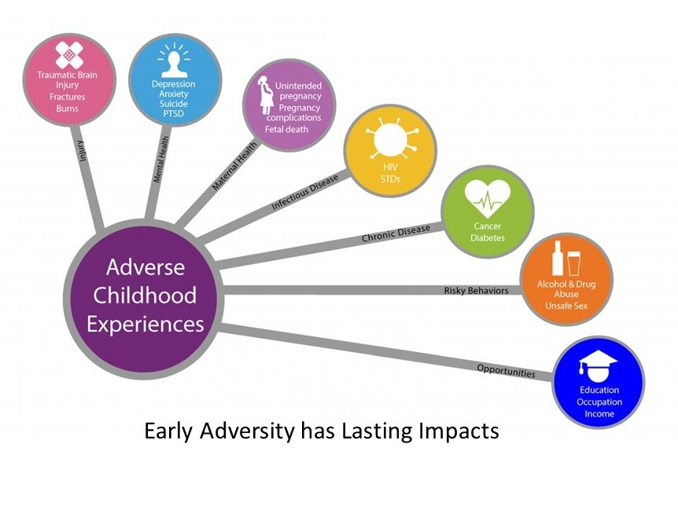

Slide 48
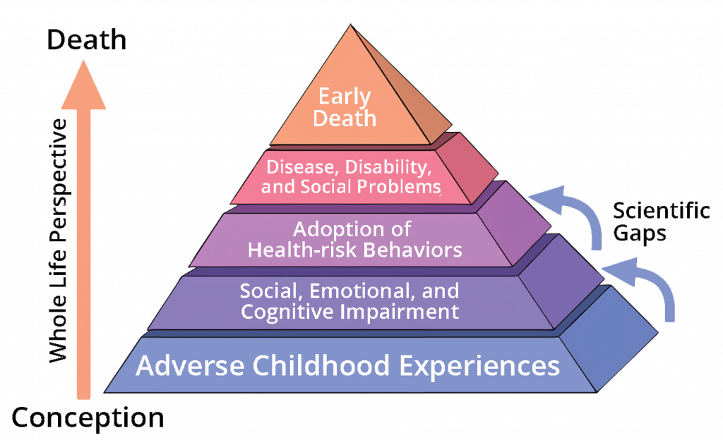

Slide 49
MIDDLE AND LATE CHILDHOOD

Slide 50

DEVELOPMENT
Spans the ages between early childhood and adolescence, approximately ages 6 to 11.
Gain greater control over the movement of their bodies, mastering many gross and fine motor skills.
Changes in the brain during this age enable not only physical development but contributes to greater reasoning and flexibility of thought.
School becomes a big part of middle and late childhood
Peers start to take center-stage, often prompting changes in the parent-child relationship.
Peer acceptance also influences children’s perception of self and may have consequences for emotional development beyond these years.

Slide 51
The hippocampus, responsible for transferring information from the short-term to long-term memory, increases in myelination resulting in improvements in memory functioning (Rolls, 2000).
Children in middle to late childhood are also better able to plan, coordinate activity using both left and right hemispheres of the brain.
Ability to control emotional outbursts.
Paying attention is also improved as the prefrontal cortex matures

Slide 52

SPORTS
Sports are important for children. Children’s participation in sports has been linked to:
Higher levels of satisfaction with family and overall quality of life in children
Improved physical and emotional development
Better academic performance
A study on children’s sports in the United States (Sabo & Veliz, 2008) has found that gender, poverty, location, ethnicity, and disability can limit opportunities to engage in sports.

Slide 53



The word concrete refers to that which is tangible; that which can be seen, touched, or experienced directly.
This involves mastering the use of logic in concrete ways.
PIAGET AND CONCRETE OPERATIONAL STAGE
uses INDUCTIVE REASONING, which is a logical process in which multiple premises believed to be true are combined to obtain a specific conclusion.

Slide 54
INFORMATION PROCESSING
DEVELOPMENT | DESCRIPTION
WORKING MEMORY | an increase in processing speed and the ability to inhibit irrelevant information from entering memory are contributing to the greater efficiency of working memory.
ATTENTION | ability to inhibit irrelevant information improves, improve in their ability to shift their attention between tasks or different features of a task
MEMORY STRATEGIES | rehearsing information you wish to recall, visualizing and organizing information, creating rhymes, inventing acronyms, such as “roygbiv” to remember the colors of the rainbow.
METACOGNITION | refers to the knowledge we have about our own thinking and our ability to use this awareness to regulate our own cognitive processes.
CRITICAL THINKING | detailed examination of beliefs, courses of action, and evidence, involves teaching children how to think. The purpose of critical thinking is to evaluate information in ways that help us make informed decisions.

Slide 55
COMMUNICATION DISORDER
DISORDER | DESCRIPTION
FLUENCY DISORDERS / STUTTERING | affect the rate of speech. Speech may be labored and slow, or too fast for listeners to follow. The most common fluency disorder is stuttering.
ARTICULATION DISORDER | refers to the inability to correctly produce speech sounds (phonemes) because of imprecise placement, timing, pressure, speed, or flow of movement of the lips, tongue, or throat.
VOICE DISORDER | involve problems with pitch, loudness, and quality of the voice

Slide 56
CHILDREN’S DISABILITIES
DISABILITY | DESCRIPTION
LEARNING DISABILITY | is a specific impairment of academic learning that interferes with a specific aspect of schoolwork and that reduces a student's academic performance significantly.
DYSLEXIA | involves having difficulty in the area of reading. This diagnosis is used for a number of reading difficulties.
DYSGRAPHIA | refers to a writing disability that is often associated with dyslexia. There are different types of dysgraphia, including phonological dysgraphia when the person cannot sound out words and write them phonetically.
DYSCALCULIA | refers to problems in math.
ADHD | shows a constant pattern of inattention and/or hyperactive and impulsive behavior that interferes with normal functioning

Slide 57
ERIKSON: INDUSTRY VS. INFERIORITY children are very busy or industrious.
SELF-CONCEPT refers to beliefs about general personal identity (Seiffert, 2011), include personal attributes, such as one’s age, physical characteristics, behaviors, and competencies.
SELF-EFFICACY is the belief that you are capable of carrying out a specific task or of reaching a specific goal.
KOHLBERG’S STAGES OF MORAL DEVELOPMENT
we learn our moral values through active thinking and reasoning, and that moral development follows a series of stages.
SELF ESTEEM which is defined as an evaluation of one’s identity

Slide 58
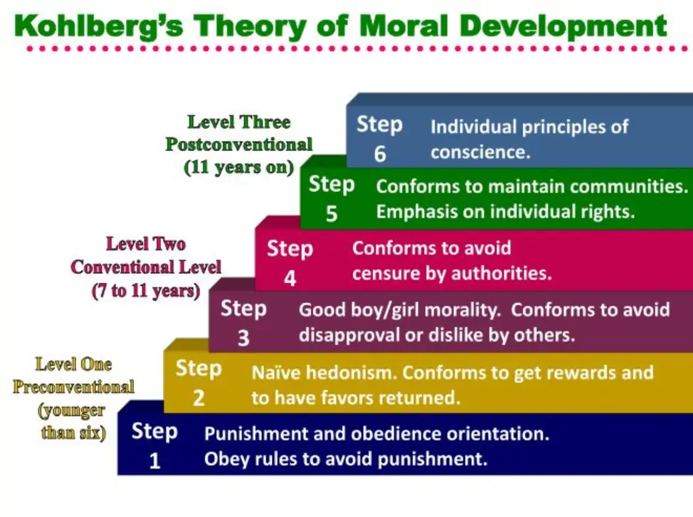

Slide 59
ADOLESCENCE

Slide 60

DEVELOPMENT
Begins with puberty and ends with the transition to adulthood (approximately ages 10–18).
Physical changes associated with puberty are triggered by hormones.
Changes happen at different rates in distinct parts of the brain and increase adolescents’ propensity for risky behavior.
Cognitive changes include improvements in complex and abstract thought. Adolescents’ relationships with parents go through a period of redefinition in which adolescents become more autonomous.
Peer relationships are important sources of support, but companionship during adolescence can also promote problem behaviors.

Slide 61

SEXUAL DEVELOPMENT
Primary sexual characteristics are changes in the reproductive organs.
For females, primary characteristics include growth of the uterus and menarche or the first menstrual period.
Secondary sexual characteristics are visible physical changes not directly linked to reproduction but signal sexual maturity.

Slide 62
Increase in the white matter of the brain and allows the adolescent to make significant improvements in their thinking and processing skills.
The hippocampus becomes more strongly connected to the frontal lobes, allowing for greater integration of memory and experiences into our decision making.
The limbic system, which regulates emotion and reward, is linked to the hormonal changes that occur at puberty.
Prefrontal cortex which is involved in the control of impulses, organization, planning, and making good decisions, does not fully develop until the mid-20s.

Slide 63
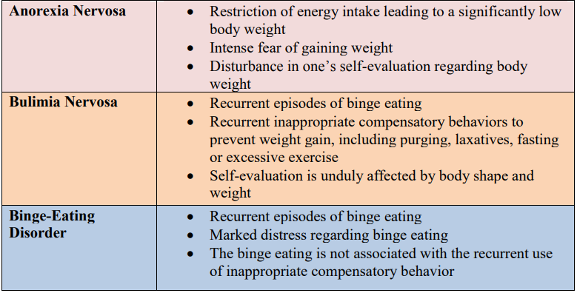
EATING DISORDERS

Slide 64



They can now contemplate such abstract constructs as beauty, love, freedom, and morality.
adolescents are able to understand abstract principles which have no physical reference.
HYPOTHETICAL-DEDUCTIVE REASONING - developing hypotheses based on what might logically occur.
ADOLESCENT EGOCENTRISM: Once adolescents can understand abstract thoughts, they enter a world of hypothetical possibilities and demonstrate egocentrism or a heightened self-focus.
PIAGET AND FORMAL OPERATIONAL STAGE

Slide 65
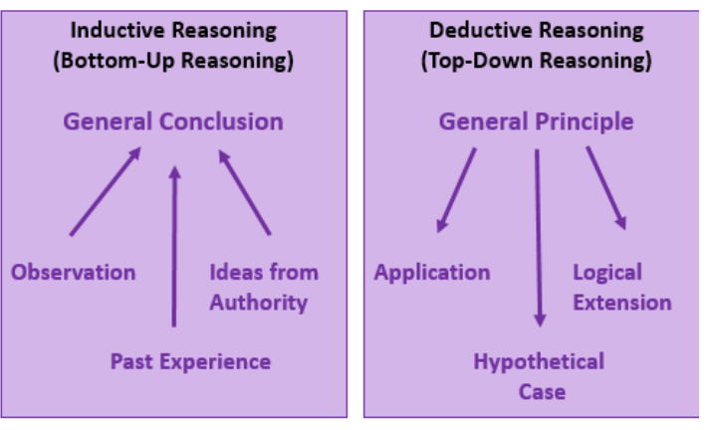
INFORMATION PROCESSING

Slide 66
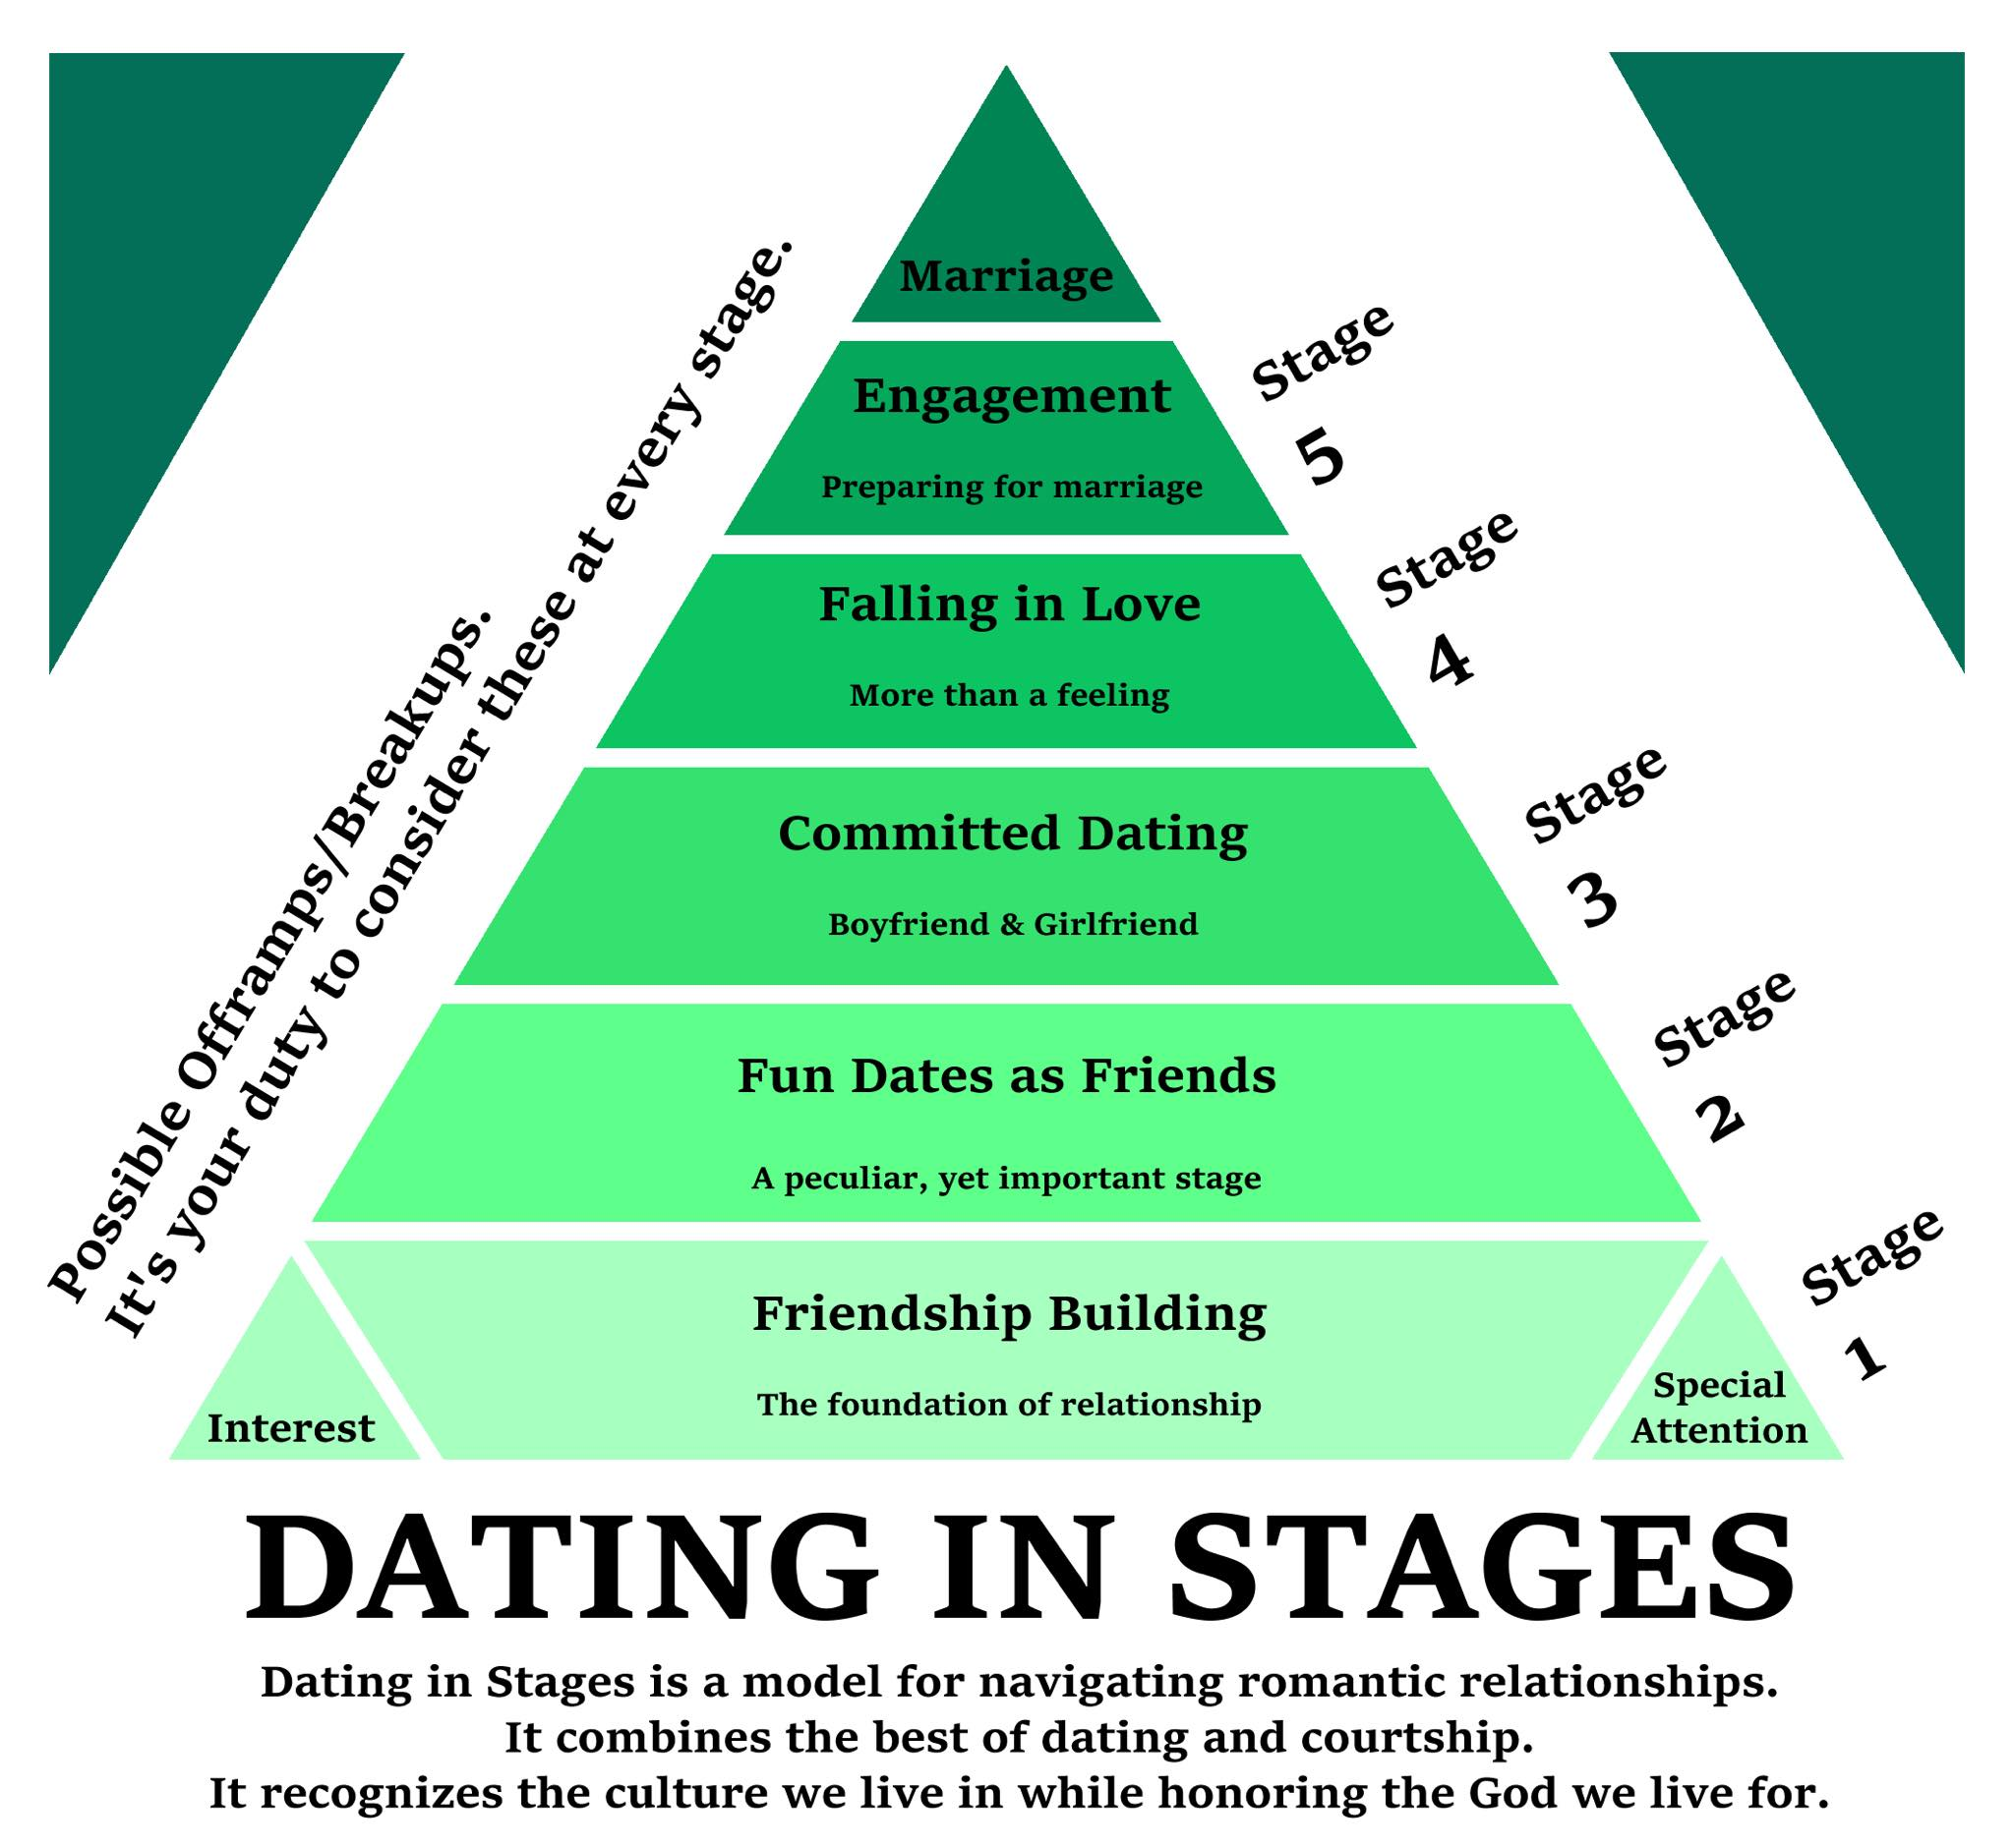
DATING AND RELATIONSHIP

Slide 67
EMERGING AND EARLY ADULTHOOD

Slide 68
DEVELOPMENT
early adulthood spanned from approximately 18 (the end of adolescence) until 40 to 45 (beginning of middle adulthood).
More recently, developmentalists have divided this age period into two separate stages: Emerging adulthood followed by early adulthood.
AGE OF IDENTITY EXPLORATION - people are exploring their career choices and ideas about intimate relationships, setting the foundation for adulthood.
AGE OF INSTABILITY - Emerging adults change jobs, relationships, and residences more frequently than other age groups.

Slide 69
DEVELOPMENT
AGE OF SELF-FOCUS - focus more on themselves, as they realize that they have few obligations to others and that this is the time where they can do what they want with their life.
AGE OF FEELING IN BETWEEN - they may still be financially dependent on their parents to some degree, and they have not completely attained some of the indicators of adulthood.
AGE OF POSSIBILITIES - dreams have yet to be tested.

Slide 70

PHYSIOLOGICAL PEAK
Physical maturation is complete, including muscle strength, reaction time, sensory abilities, and cardiac functioning.
The reproductive system, motor skills, strength, and lung capacity are all operating at their best.
Most professional athletes are at the top of their game during this stage, and many women have children in the early-adulthood years.
Around the age of 30, many changes begin to occur in different parts of the body

Slide 71



Adults are also not as influenced by what others think.
This advanced type of thinking is referred to as POSTFORMAL THOUGHT
They learn to base decisions on what is realistic and practical, not idealistic, and can make adaptive choices.
PIAGET AND POST FORMAL STAGE
The ability to bring together salient aspects of two opposing viewpoints or positions is referred to as DIALECTICAL THOUGHT

Slide 72
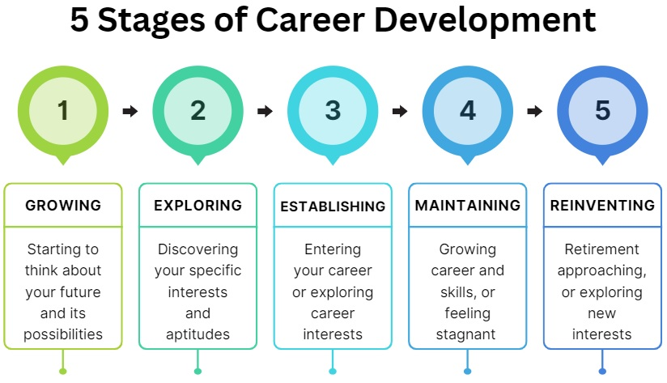
CAREER DEVELOPMENT & EMPLOYMENT

Slide 73
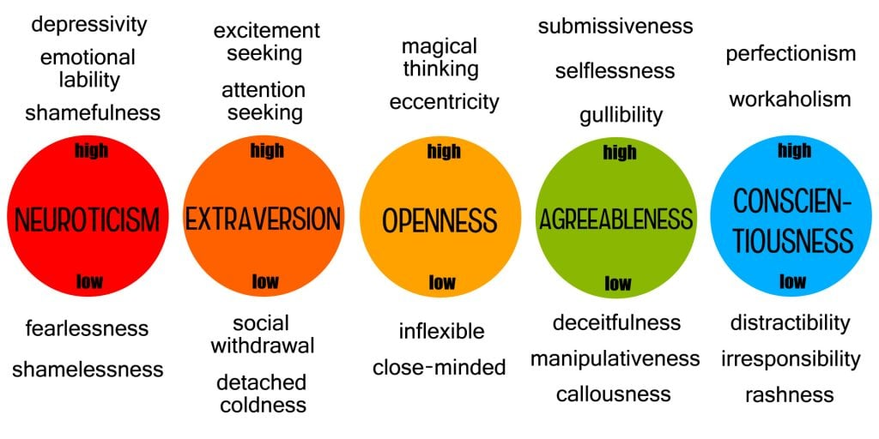
PERSONALITY DEVELOPMENT

Slide 74
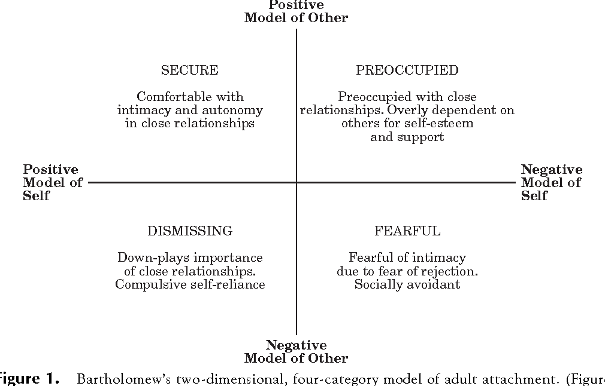
ATTACHMENT THEORY

Slide 75
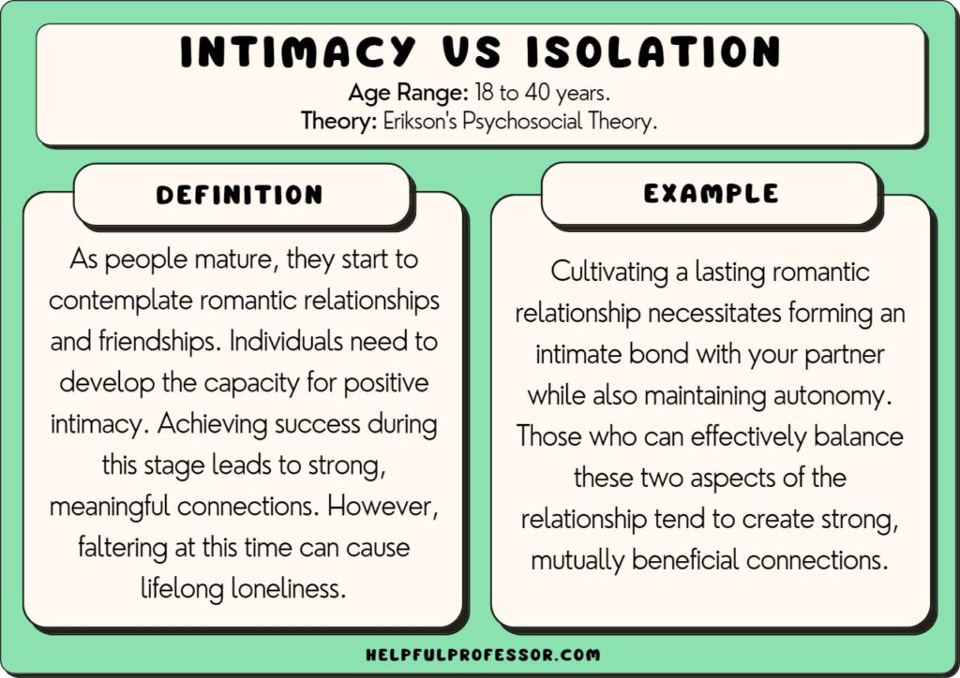

Slide 76
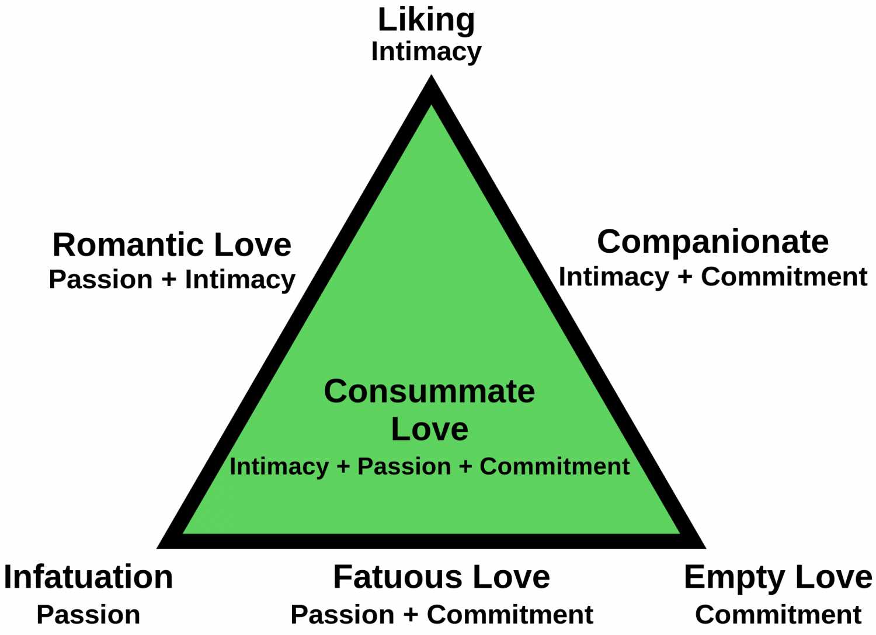
STERNBERG’S TRIARCHIC THEORY OF LOVE

Slide 77
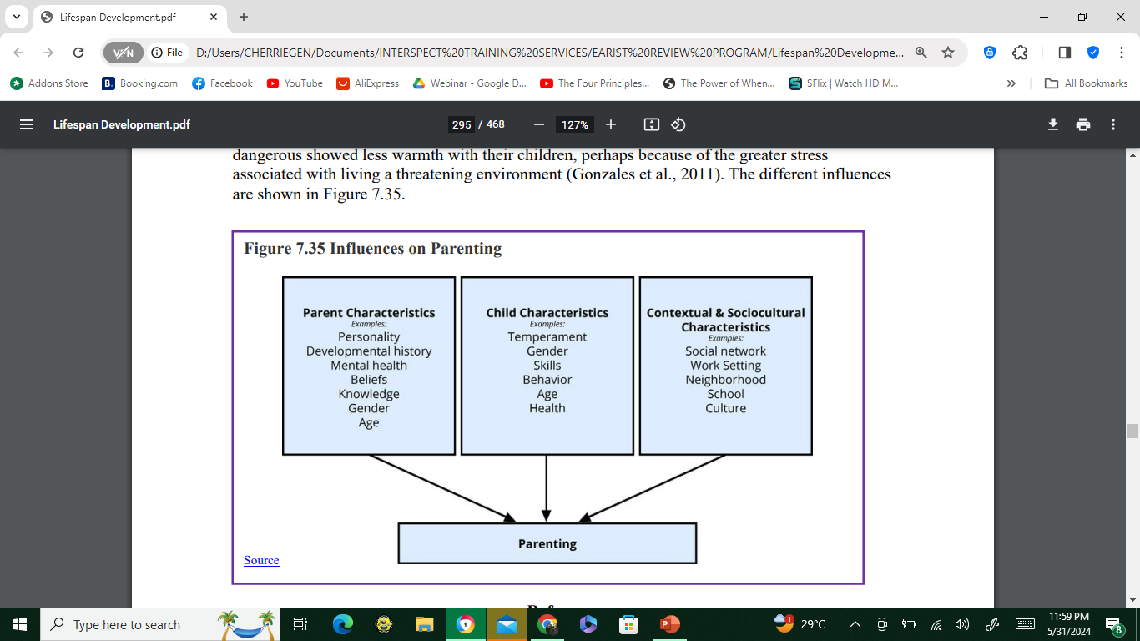
PARENTING

Slide 78
MIDDLE and LATE ADULTHOOD

Slide 79

DEVELOPMENT
MIDLIFE, refers to the period of the lifespan between early adulthood and late adulthood.
Although ages and tasks are culturally defined, the most common age definition is from 40-45 to 60-65.
PRIMARY AGING – when a person experiences age-related physical changes based on many factors: biological factors, such as molecular and cellular changes, and oxidative damage
SECONDARY AGING - aging that occurs due to controllable factors, such as an unhealthy lifestyle including lack of physical exercise and poor diet.

Slide 80
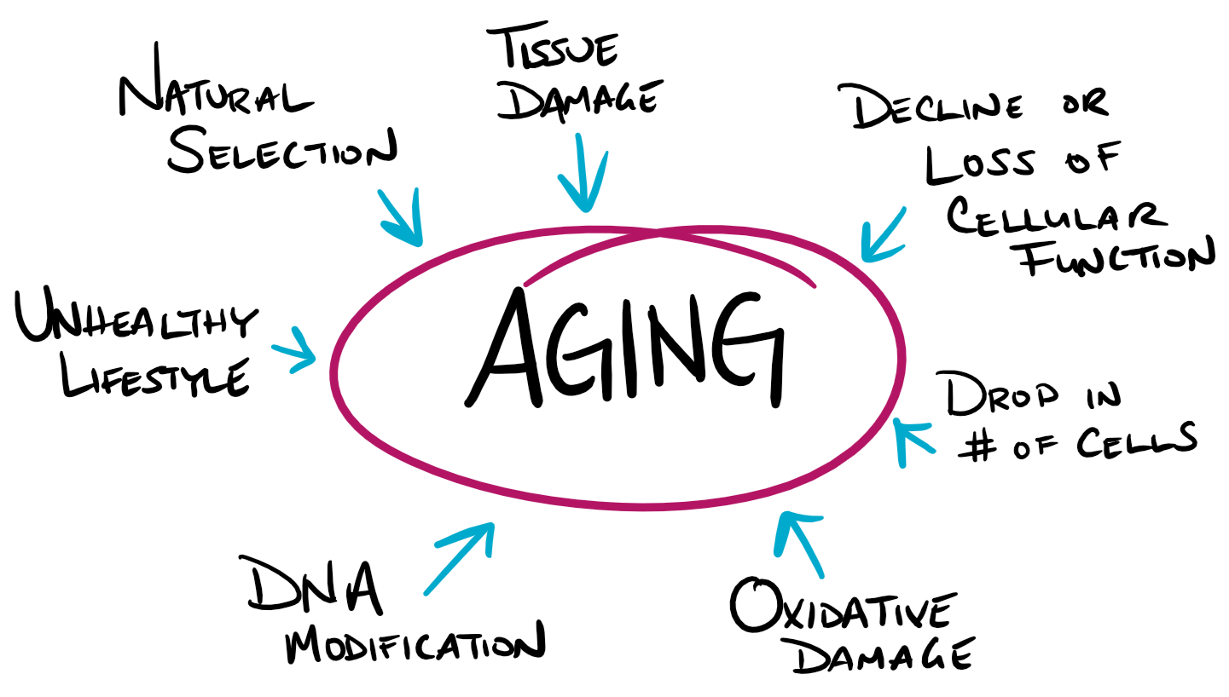
AGING

Slide 81
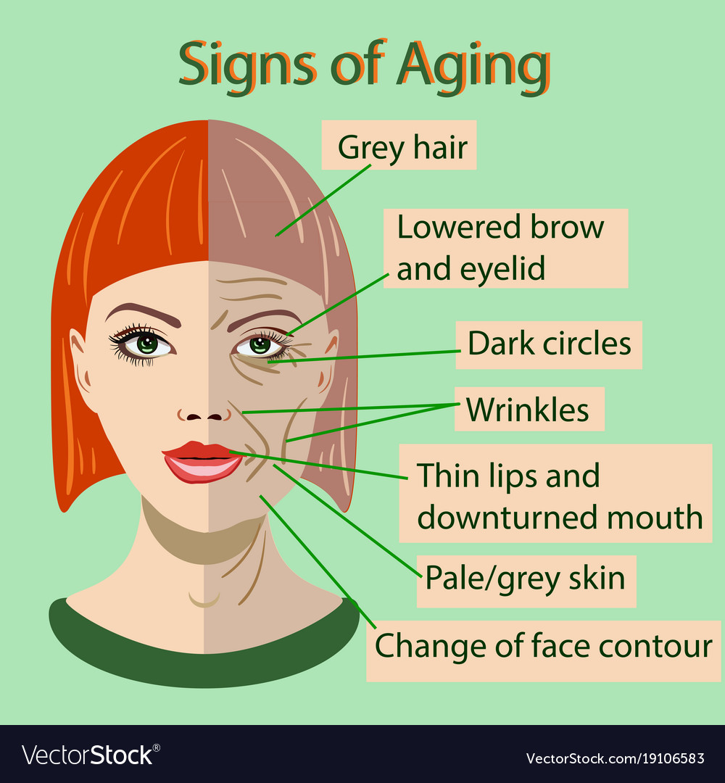
AGING

Slide 82
AGING PROBLEMS
PROBLEM | DESCRIPTION
SARCOPENIA | The loss of muscle mass and strength that occurs with aging.
LUNG PROBLEMS | Thinning of the bones with age can change the shape of the rib cage and result in a loss of lung expansion.
PRESBYOPIA | A normal change of the eye due to age, called “old vision.” It refers to a loss of elasticity in the lens of the eye that makes it harder for the eye to focus on objects that are closer to the person.
ATHEROSCLEROSIS | a buildup of fatty plaque in the arteries, is the most common cause of cardiovascular disease.
HYPERTENSION | high blood pressure, is a serious health problem that occurs when the blood flows with a greater force than normal.
CANCER | body’s cells begin to divide without stopping and spread into surrounding tissues.
DIABETES | (Diabetes Mellitus) is a disease in which the body does not control the amount of glucose in the blood.

Slide 83

CONSEQUENCES OF LACK OF SLEEP
Suppresses immune responses that fight off infection.
Can lead to obesity, memory impairment, and hypertension.
Increased risk for colon cancer, breast cancer, heart disease and type 2 diabetes.
Can increase stress as cortisol (a stress hormone) remains elevated which keeps the body in a state of alertness and hyperarousal which increases blood pressure.

Slide 84
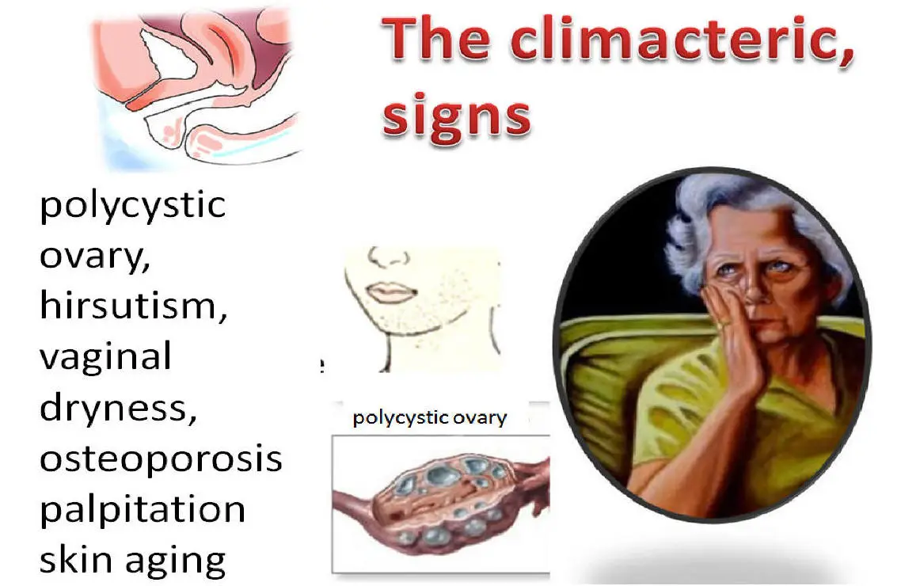
FERTILITY DECLINES

Slide 85

MIDLIFE CRISIS

Slide 86



during which one established a family and career, was the longest of all the stages.
GENERATIVITY encompasses procreativity, productivity, and creativity.
ERIKSON:
GENERATIVITY VS STAGNATION
leaving a positive legacy of themselves, and parenthood is the primary generative type.
STAGNATION occurs when one is not active in generative matters, however, stagnation can motive a person to redirect energies into more meaningful activities.

Slide 87

RELATIONSHIPS
SANDWICH GENERATION refers to adults who have at least one parent age 65 or older and are either raising their own children or providing support for their grown children.
KINKEEPER - In all families there is a person or persons who keep the family connected and who promote solidarity and continuity in the family.
EMPTY NEST, or post-parental period refers to the time period when children are grown up and have left home.

Slide 88

OLD AGE
“GRAYING OF THE WORLD”
Even though the United States is aging, it is still younger than most other developed countries.
Germany, Italy, and Japan all had at least 20% of their population aged 65 and over in 2012, and Japan had the highest percentage of elderly.
According to the World Health Organization (WHO) (2019) GLOBAL LIFE EXPECTANCY for those born in 2019 is 72.0 years, with females reaching 74.2 years and males reaching 69.8 years.

Slide 89
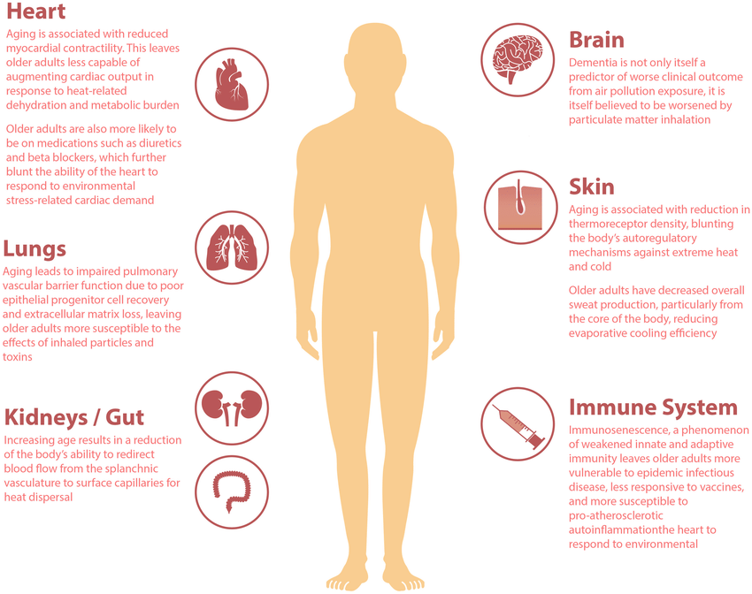
PHYSICAL CHANGES OF AGING

Slide 90

IMPROVING QUALITY OF LIFE
By exercising, reducing stress, stopping smoking, limiting use of alcohol, and consuming more fruits and vegetables, older adults can expect to live longer and more active lives.
Stress reduction, both in late adulthood and earlier in life, is also crucial. The reduction of societal stressors can promote active life expectancy.
In the last 40 years, smoking rates have decreased, but obesity has increased, and physical activity has only modestly increased.

Slide 91


